Slide 1

Programming GPUs with CUDA:
Introduction to GPUs
Lara Querciagrossa, Andrew Emerson, Nitin Shukla, Luca Ferraro, Sergio Orlandini
l.querciagrossa@cineca.it
July 12th, 2022

Slide 2

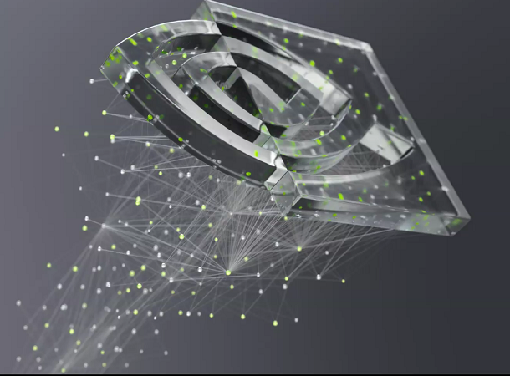
In this lecture…
What are GPUs
CPUs vs GPUs
GPU architecture
How to accelerate applications
GPGPU programming model

Slide 3


Introduction to GPU

Slide 4
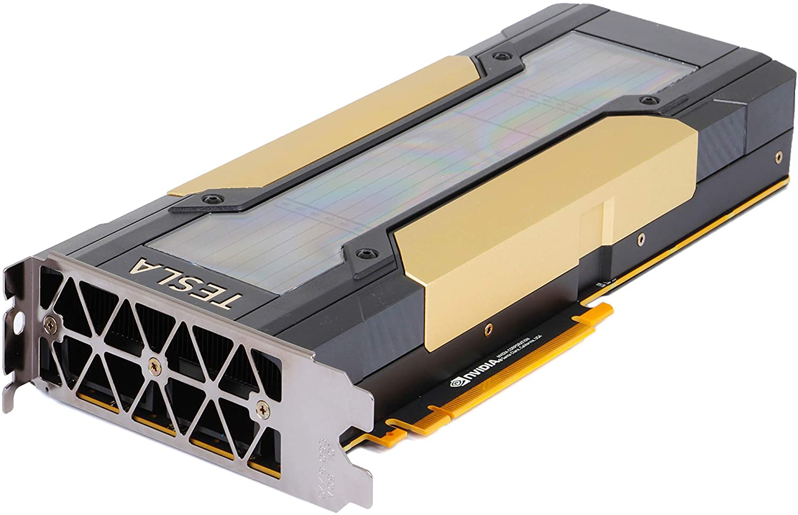
What are GPUs?
GPU stands for Graphics Processing Units
It is a device equipped with:
highly parallel microprocessor (thousands of cores),
private memory with very high bandwidth (about 900 GB/s).
GPUs highly parallel structures makes them more efficient w.r.t. CPUs for embarrassing parallel algorithms:
CPUs race through a series of task requiring lots of interactivity;
GPUs break complex problems into thousands or millions of separate tasks and work them out at one.

Slide 5
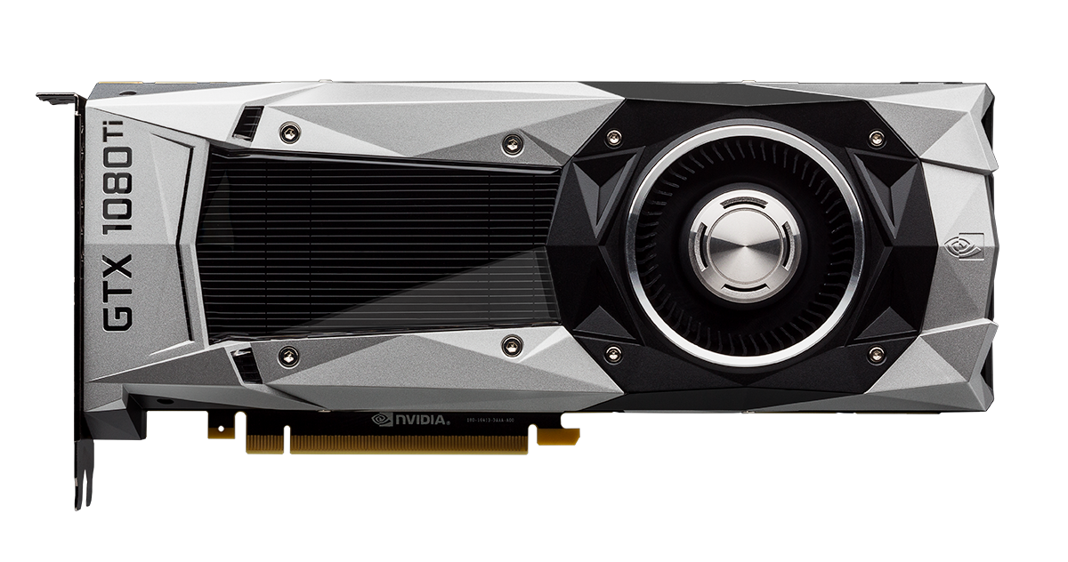
What are GPUs?
Born in '90 as a response to the growing demand for high-definition 3D graphics (gaming, animations, etc), where textures, lighting and the rendering of shapes should be done on the fly.
Now routinely used in HPC and machine learning applications.
Most important vendors: NVIDIA, AMD, …
Different solutions depending on the purpose:
Workstations running professional applications
Gaming
HPC/GPGPU
“The CPU has been called the brain of a PC. The GPU its soul.“ [1]

Slide 6

Parallel Intensive Computation
GPUs are designed to render complex 3D scenes composed of millions of data points/vertex at high frame rates (60-120 FPS).
The rendering process requires a set of transformations based on linear algebra operations and (mostly local) filters:
the same set of operations are applied on each data point of the scene;
each operation is independent of each other;
all operations are performed in parallel using a huge number of threads which process all data independently.

Slide 7
SPMD: Single Program Multiple Data
If the set of transformations can be applied independently on each point, the output result is independent on the order of point computation.
If transformations are independent, we can speed up the elaboration using parallel work:
apply the same transformation (Single Program) ...
... to each point (Multiple Data)
... using multiple threads concurrently.
for (int i = 0; i < N; i++) {
C[i] = A[i] + B[i];
}

Slide 8
What is a THREAD?
A thread is an independent flow of execution of a program which share the same memory resources of the main process (access to main data)
A process can spawn multiple threads of execution, each can follow an independent flow
Threads inside a process can:
exchange data because they share the same memory of the program
use local memory not shared with other threads
synchronize with other threads (waiting dependences)
Thread
Thread
Thread

Slide 9
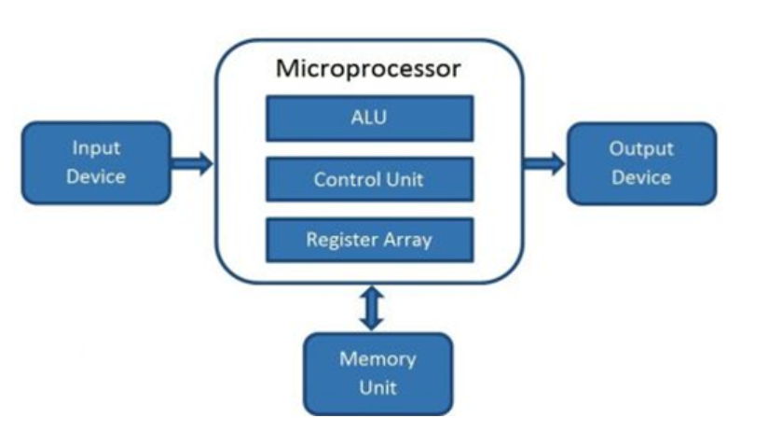
Concurrency using CPU threads
Threads can run concurrently as long as there is available hardware to use for their execution (registers and ALUs).
Arithmetic Logic Unit is a combinational digital circuit that performs arithmetic and bitwise operations on integer binary number.
Control Unit directs the operations of the processor by providing timing and control signals to synchronize these operations
Registers store data before or currently processing and are part of CPU.
Notes:
(vs cache memory that store processed or recently used data and can be both con CPU or motherboard)

Slide 10
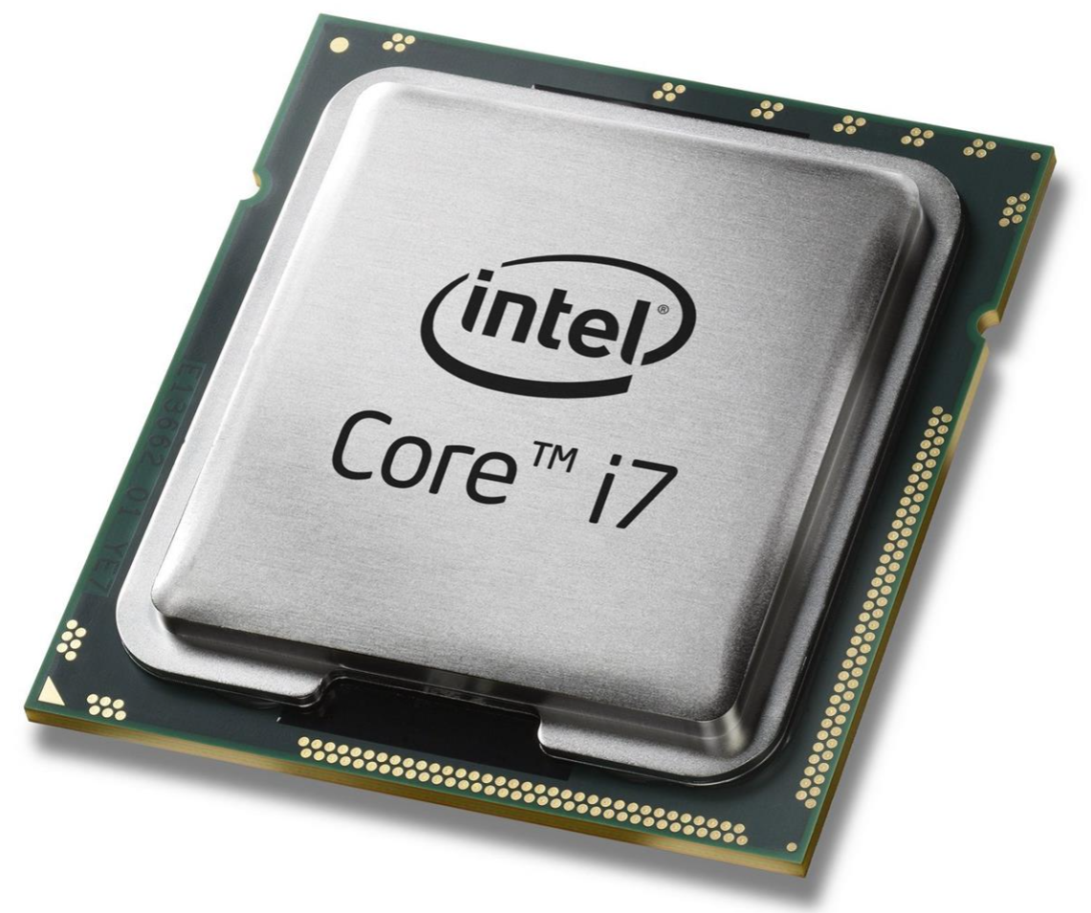
Concurrency using CPU threads
Modern CPUs often have multiple cores on chip: each core has registers and ALU units to run a thread independently from other cores
When there are more threads on the fly than available cores, the operating system can make a context switch
the running thread is freezed: all information about its status is saved and put back for later restore
a new thread take the hardware resources, load its previous status and restart its flow until a new context switch will take place
CPU threads context switch involves many backup operations, plus the fact that data is no longer in registers and caches
Notes:
Register = small amount of fast storage

Slide 11
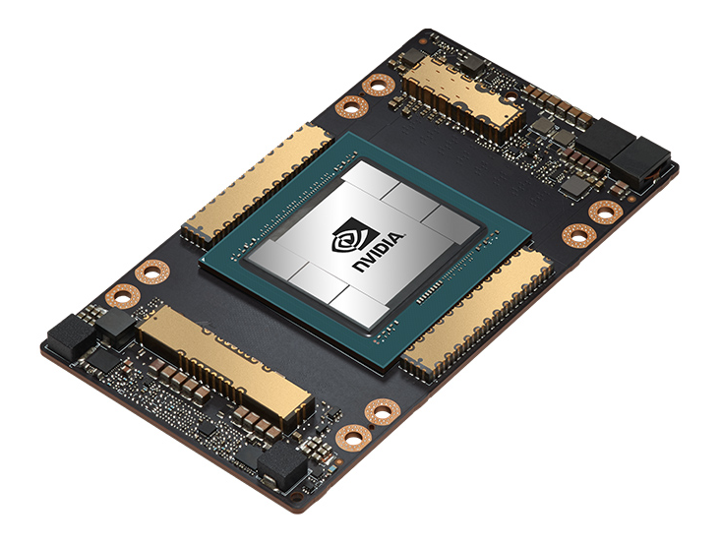
CPU threads vs GPU threads
GPU are able to manage thousands of threads efficiently
GPU threads are extremely light weighted
GPU have thousands of available registers
each thread running on a GPU maintains its status in its own registers
no penalty in case of a context-switch
The more threads are in flight,
the more the GPU hardware
is able to hide memory or
computational latencies
Notes:
Register = small amount of fast storage

Slide 12
Summing up: CPUs vs GPUs

Slide 13
CPU vs GPU
A Central Processing Unit (CPU) is a latency-optimized general purpose processor designed to handle a wide range of tasks sequentially.
Graphics Processing Unit (GPU) is a throughput-optimized specialized processor designed for high-end parallel computing.
Massive Parallel Computing: extensive calculations with similar operations
High Data Throughput: thousands of cores performing the same operation on multiple data items in parallel
High Computing Throughput: high-performance computing power
Notes:
Register = small amount of fast storage

Slide 14
CPU vs GPU architecture
CPU
just a few cores (8-32)
large cache, low latency
tens of software threads at a time
task parallelism
GPU
thousands of cores (5k)
small memory, large bandwidth
thousands of threads simultaneously
data parallelism
CPU
GPU
Control
ALU
ALU
ALU
ALU
Cache
DRAM
DRAM

Slide 15


Why using GPUs?
Very large number of “cores” (better performance w.r.t. CPU applicationss).
Often low cost ($/Flop) and low energy consumption (Watts/Flop).
May need complete rewrite of application.
Low device memory (max 16/32 Gb).
Depending on model, possible low transfer speeds

Slide 16
GPU architecture

Slide 17
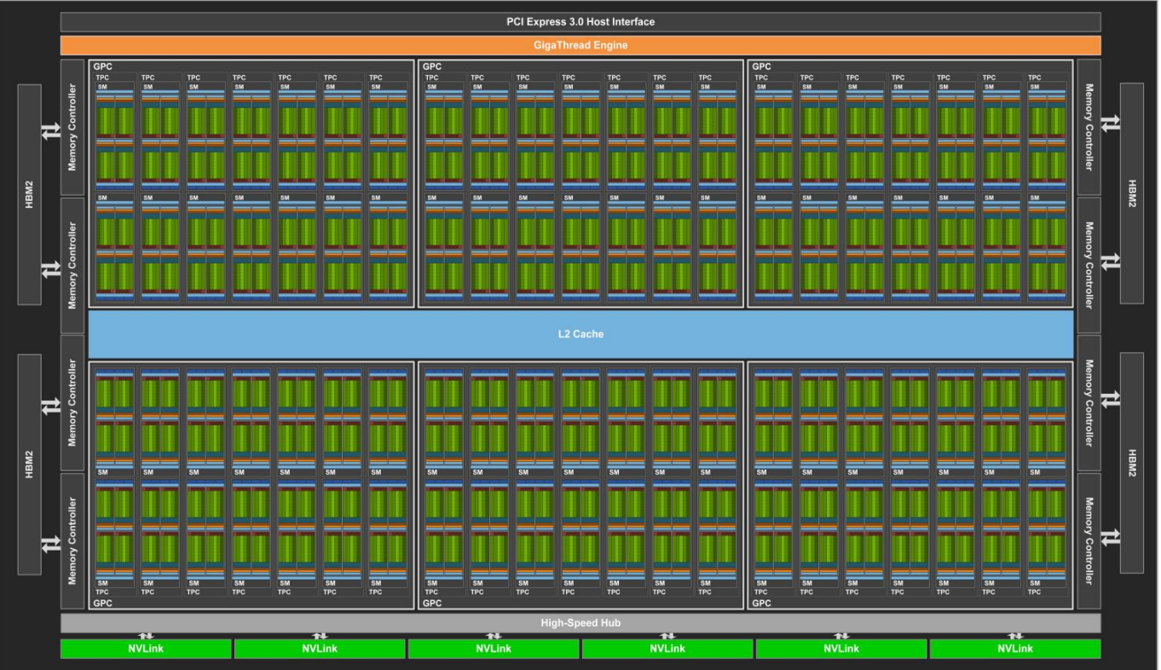
GPU architecture scheme
Main global memory
medium size (16-40 GB)
very high bandwidth (800-1200 GB/s)
Streaming Multiprocessors (SM)
grouping independent cores and control units
number of SM depends on GPU architecture
~16-32 up to ~100 SM on modern GPUs
Volta GV100 Full GPU with 84 SM Units
Notes:
Register = small amount of fast storage

Slide 18
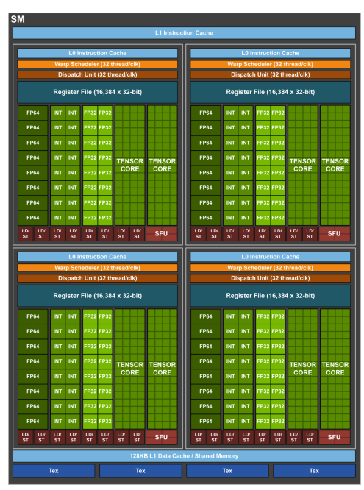
GPU architecture scheme
Each SM unit has:
many cores ( > 100 cores)
lots of registers (32K-64K)
instruction scheduler dispatchers
shared memory with fast access to data
several caches
Host/Device connection technology (NVLink, PCIExpress, AMD Infinity Fabric) → data movement bottleneck
Volta GV100 Streaming Multiprocessor
Notes:
Register = small amount of fast storage

Slide 19
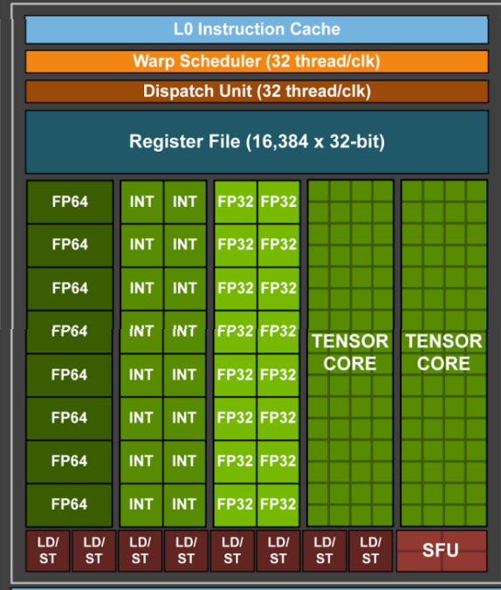
GPU functional unit types
FP32: performs 32-bit floating point
operations.
INT32: performs 32-bit and maybe some logical
operations.
FP64: executes 64-bit FP operations.
Special Functional Unit (SFU): performs reciprocal (1x) and transcendental instructions.
Load/Store (LS): performs loads and stores from all memory address spaces.
Tensor Core: specialized units to compute A*B+C matrix product.
Volta GV100 functional unit types
Notes:
Register = small amount of fast storage

Slide 20
NVIDIA Volta V100 architecture (2017)
https://developer.nvidia.com/blog/inside-volta
A full GV100 GPU unit contains 6 Compute Graphic Clusters (CGC) with 14 SM each, total 84 SMs
5376 FP32 cores
5376 INT32 cores
6MB L2 cache
High Bandwidth Memory
16 GB HBM2 SDRAM
900 GB/s bandwidth
NVLink technology
300GB/s bandwidth
Peak Performance:
15.7 FP32 TFlops
Max Power Consumption:
300W
Volta GV100 Full GPU with 84 SM Units
Notes:
Register = small amount of fast storage

Slide 21
NVIDIA Volta V100 architecture (2017)
SM composed of 4 independent blocks
each block sports:
1 warps x 2 dispatchers
16FP32 + 16INT32 ALU units
separate FP32 and INT32 cores, allowing simultaneous execution of FP32 and INT32 operations at full throughput
8 FP64 ALU units
2 Tensor Core units (HW matmul)
8 Load/Store units
4 SFU units
32768 32bits registers
each block accesses:
128KB for L1/shared memory
4 texture units
Volta GV100 Streaming Multiprocessor
Notes:
Warps: dirgli che cos’è o dirgli che lo vedremo

Slide 22
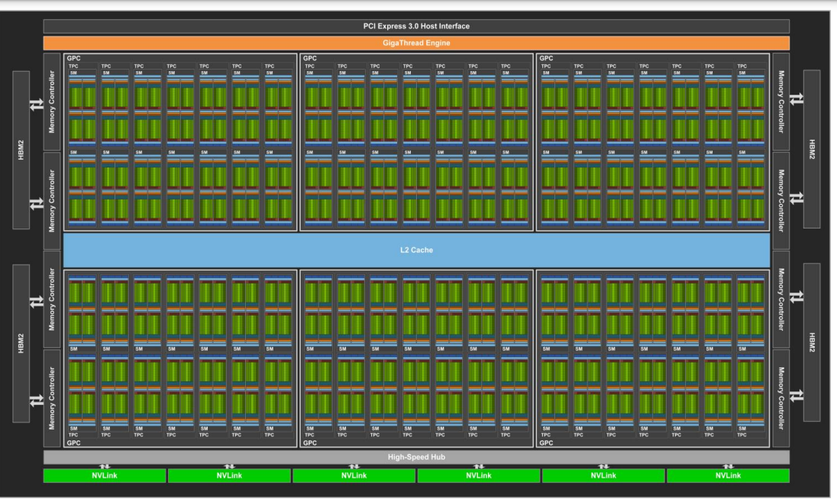
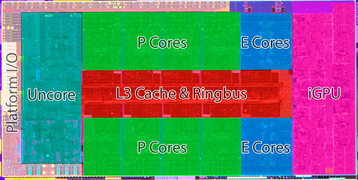
CPU vs GPU architecture
Volta GV100 Full GPU with 84 SM Units

Slide 23
Accelerating applications

Slide 24
How do I accelerate applications?
Programming languages
Libraries
Directives
«Drop in» accelerations
Easily accelerate applications
Maximum flexibility
Portability
Performance

Slide 25

How do I accelerate applications?
Programming languages
Libraries
Directives
«Drop in» accelerations
Easily accelerate applications
Maximum flexibility
cuBLAS: CUDA Basic Linear Algebra Subroutines
cuSPARSE for sparse matrices
support for all 152 standard BLAS routines
mixed and low precision support
CUDA streams support

Slide 26

How do I accelerate applications?
Programming languages
Libraries
Directives
«Drop in» accelerations
Easily accelerate applications
Maximum flexibility
MAGMA: Matrix Algebra for GPU and Multicore Architecture
hybrid approach: small non-parallelizable tasks are run on CPU, large and parallel ones on GPU, bounded with communication
data dependencies among tasks used to properly scheduling tasks' execution over multicore and GPU hardware components
built on top of CUDA

Slide 27

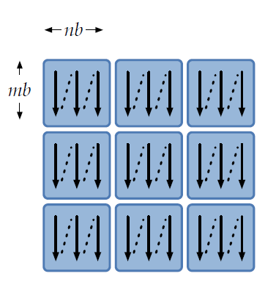
How do I accelerate applications?
Programming languages
Libraries
Directives
«Drop in» accelerations
Easily accelerate applications
Maximum flexibility
SLATE: Software for Linear Algebra Targeting Exascale
based on tile layout and tile algorithms
flexible: not-uniform size blocks, arbitraty matrix distribution
standard based: MPI, OpenMP, GPU support with cuBLAS
task-based parallelism

Slide 28

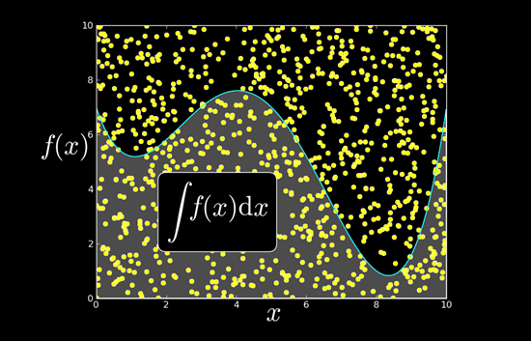
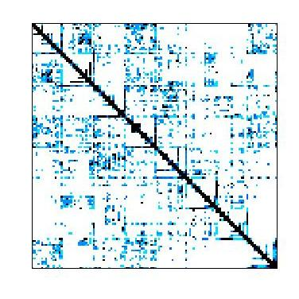


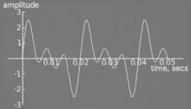







How do I accelerate applications?
Programming languages
Libraries
Directives
NVIDIA cuBLAS
NVIDIA cuRAND
NVIDIA cuSPARSE
NVIDIA NPP
«Drop in» accelerations
Easily accelerate applications
Maximum flexibility
Vector Signal Image Processing
GPU Accelerated
Linear Algebra
Matrix Algebra on GPU and Multicore
NVIDIA cuFFT
Building-block Algorithms for CUDA
Sparse Linear Algebra
C++ STL Features for CUDA
IMSL Library
ArrayFire Matrix Computations

Slide 29


How do I accelerate applications?
Programming languages
Libraries
Directives
«Drop in» accelerations
Easily accelerate applications
Maximum flexibility
openMP from v 4.0 allows offloading of tasks onto GPUs
openACC allows to annotate areas of code that should be accelerated using compiler directives and additional functions
…

Slide 30


How do I accelerate applications?
Programming languages
Libraries
Directives
«Drop in» accelerations
Easily accelerate applications
Maximum flexibility
CUDA: C extension, developed by NVIDIA, PGI compiler, FORTRAN extension.
OpenCL: General framework for writing programs across heterogenous devices. Often used for non-NVIDIA GPUs and FPGAs. Open source. Low level and verbose language.
Notes:
FPGA = field-programmable gate arrays

Slide 31




How do I accelerate applications?
Programming languages
Libraries
Directives
«Drop in» accelerations
Easily accelerate applications
Maximum flexibility
HIP: developed by AMD, interface similar to CUDA, designed to easily convert existing CUDA code (HIPify tool to automate this conversion)
Python support: pyCUDA, cuPy (open source NumPy/SciPy compatible lib), numba (decorators or CUDA language)

Slide 32



How do I accelerate applications?
Programming languages
Libraries
Directives
«Drop in» accelerations
Easily accelerate applications
Maximum flexibility
oneAPI: developed by Intel
SYCL: developed by Khronos Group (as OpenCL)
DirectCompute: developed by Microsoft

Slide 33
GPGPU Programming Model

Slide 34
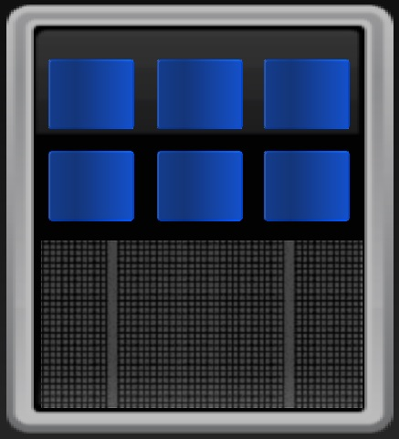
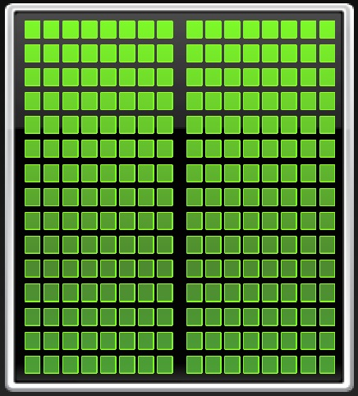
GPGPU programming model
General Purpose GPU Programming relates to use GPU computational power to solve problems other than graphics.
CPU and GPU are separate devices with separate memory space addresses.
GPU is seen as an auxiliary coprocessor equipped with thousands of cores and a high bandwidth memory.
They should work together for best benefit and performances.
CPU
GPU
Notes:
Register = small amount of fast storage

Slide 35
GPGPU programming model
Optimized for low-latency accesses to caches data sets
Control logic for out-of-order and speculative execution
Best for serial or event driven tasks
Optimized for data-parallel, throughput computation
Architecture tolerant of memory latency
Best for data-parallel tasks
CPU
GPU
CPU
GPU
Notes:
Register = small amount of fast storage

Slide 36
GPGPU programming model
Serial, or processes with low parallelism, remain on the CPU.
Computational intensive high parallel regions are offloaded to the GPU for processing.
GPU
CPU
Notes:
Register = small amount of fast storage

Slide 37
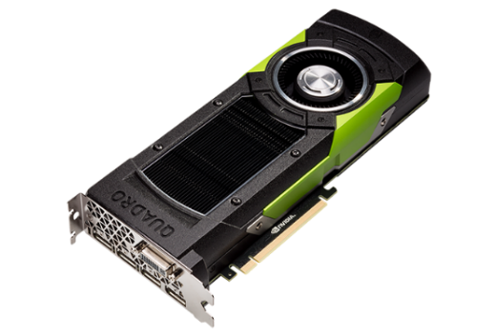
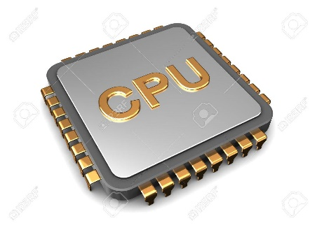
GPGPU programming model
Required data is moved on GPU memory and back to the HOST: connection to device is relatively slow so minimise data transfers.
The GPU’s threads need to be saturated otherwise the result will be slower than CPU.
For max performance, execution on the CPU should continue as much as possible while GPU is being used.
offload data to GPU
PCI-e express (~ 8 Gb/s)
copy back results
Notes:
Register = small amount of fast storage

Slide 38
CUDA Programming

Slide 39
Compute Unified Device Architecture
Parallel computing platform and API created by NVIDIA for programming on GPUs.
Originally only for C/C++ but now FORTRAN API is available with PGI compilers.
First version of the SDK (Software Development Kit) arrived in 2007 (CUDA-1) - in 2019 we now have CUDA -10.
The SDK includes:
Drivers, runtimes and API
Compiler wrappers for compiling cuda code (nvcc)
Libraries (cuBLAS, cuFFT, cuSolver, etc)
Debuggers (cuda-gdb, cuda-memcheck), profilers (nvprof, nView), etc.
Freely downloadable from NVIDIA, but cuda-enabled GPUs are available only from NVIDIA.
Fastest solution when using NVIDIA devices.
Notes:
Register = small amount of fast storage

Slide 40
Compute Unified Device Architecture
CUDA is a general purpose parallel computing platform and programming model created by NVIDIA.
It consists of:
a hierarchical multi-threaded programming paradigm that matches GPU hardware structure,
a set of extensions to higher level programming languages (C/C++ and Fortran) to use GPU as a coprocessor for heavy parallel task and to express thread parallelism within a familiar programming environment,
a new architecture instruction set called PTX (Parallel Thread eXecution) to match GPU typical hardware,
a developer toolkit to compile, debug, profile programs and run them easily in a heterogeneous systems,
a set of GPU accelerated libraries for common scientific algorithms
Notes:
Register = small amount of fast storage

Slide 41
Compute Unified Device Architecture
CUDA C/C++ and FORTRAN API allow you to:
Control and query available GPU devices,
Manage GPU memory allocation and data transfers,
Manage and control independent work queues,
Define special language extension to express thread parallelism of selected functions (kernel) which will be executed on the GPU by thousands of threads.
Notes:
Register = small amount of fast storage

Slide 42
References

Slide 43
References
Previous editions of this school at CINECA
Oakridge National Laboratory’s “Introduction to CUDA C++”: https://www.olcf.ornl.gov/calendar/introduction-to-cuda-c/
NVIDIA DL Institute Online Course
blogs.nvidia.com
unsplash.com
Wikipedia
https://www.javatpoint.com/microprocessor-introduction
Computer register: https://www.javatpoint.com/computer-registers, https://www.geeksforgeeks.org/different-classes-of-cpu-registers/, https://alltechqueries.com/what-are-cpu-registers/
ALU: https://www.javatpoint.com/what-is-alu
https://www.learncomputerscienceonline.com/central-processing-unit/

Slide 44
THANK YOU!
Lara Querciagrossa
l.querciagrossa@cineca.it

Slide 45
La programmazione ad oggetti e le classi
C++
vs C
Caratteristiche OOP
Paradigmi di programmazione
Le classi

Slide 46
Storia del C++

Slide 47
Storia del C++
Motivazioni dietro la nascita del C++
Da dove nasce la necessità di introdurre un nuovo linguaggio di programmazione:
Riutilizzo del codice
Manutenibilità e portabilità
Sicurezza sui dati
Facilità di utilizzo
Capacità di rappresentare nuove entità in maniera semplice
“No programming language is perfect. Fortunately, a programming language does not have to be perfect to be a good tool for building great systems. In fact, a general-purpose programming language cannot be perfect for all of the many tasks to which it is put. ... Thus, C++ was designed to be a good tool for building a wide variety of systems and to allow a wide variety of ideas to be expressed directly.” (Bjarne Stroustrup)
Notes:
Fine anni 70
Portabile su altre architetture, usato da molte persone Stroustrup, fondatore, primo ideatore

Slide 48

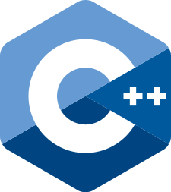
Confronto tra C e C++
Definizione di variabili
Definite solo all’inizio della funzione
Possono essere definite ovunque

Slide 49
Esercizi

Slide 50
Esercizi
1. Scrivere un codice in cui si calcola la distanza tra due punti in 2 o in 3 dimensioni, utilizzando differenti namespace.
Soluzione: https://godbolt.org/z/srTboT578
2. Scrivere una funzione che trova il più piccolo degli elementi di un array. La funzione deve poter essere utilizzata con più tipi di dati (int, double, …): si consiglia di utilizzare una funzione template.
Soluzione: https://godbolt.org/z/5WoEs59WK
3. Scrivere un codice che verifichi che il numero inserito sia compreso tra un valore minimo e massimo e lanci due eccezioni nel caso non lo sia.
Soluzione: https://godbolt.org/z/vh3zzvMae

Slide 51
ATTIVITÀ DEL TEAM DI COMUNICAZIONE (1/2)
Testo evidenziato testo non evidenziato
Testo evidenziato testo non evidenziato
Testo evidenziato testo non evidenziato Testo evidenziato
Testo evidenziato testo non evidenziato (testo molto evidenziato)
Testo non evidenziato Testo evidenziato Testo evidenziato testo non evidenziato
Testo non evidenziato Testo evidenziato
Testo evidenziato testo non evidenziato Testo evidenziato

